Slide 1
React Overview
Intro to React

Slide 2
Web basics
React Overview

Slide 3
Web application
Primary application runs on remote server
Content from the server is accessed by user through a browser
Key Examples
social media sites,
cloud file sharing and backup
web-based email
e-commerce
Notes:
Web applications are based on the operational flow we have just discussed; they involve an application program running on a remote server which is accessed via a browser-based interface. The application program is developed using standard server-side scripting languages such as PHP, Javascript, Ruby, ASP.NET as we saw earlier. The browser may have a Javascript program running in it, in what is termed called client-side scripting, or it might involve a simple static HTML page.
Pretty much anything we access on the Internet these days could be classified as a web app: social media sites such as Facebook and Instagram, cloud file backup services such as Apple’s iCloud or Microsoft’s OneDrive, web-based email such as Gmail and Outlook and e-commerce sites such as Amazon or Alibaba

Slide 4
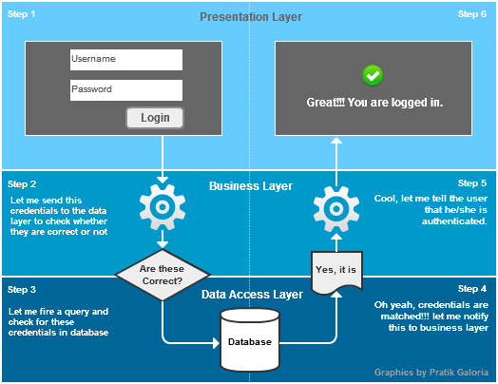
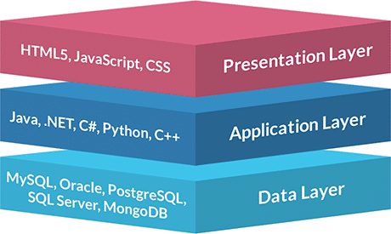
3-tier web application
Notes:
There are many architectural styles possible for a web-application, but the most commonly used one is the 3-tier model.

Slide 5
3-tier web application
Notes:
The presentation layer or tier is the front end layer which provides the graphical user interface that is typically accessible through the browser. This tier is built using HTML5, CSS and Javascript or through other popular web development frameworks such as Angular, React or Vue. This is commonly called client-side scripting. The presentation layer communicates with the business layers through API calls

Slide 6
3-tier web application
Notes:
The application or business layer contains the functional business logic which drives an application’s core capabilities. This is implemented in the remote application server using server-side scripting languages such as PHP, Python, Java,.NET and so on.

Slide 7
3-tier web application
Notes:
Finally the data tier comprises the database/data storage system. Popular examples of these are MySQL, Oracle, PostgreSQL, Microsoft SQL Server, MongoDB, etc. The database may be hosted on the same server as the business layer or on a different dedicated server. Data is accessed by the application layer again through API calls.

Slide 8
Front-end web development
HTML
Structure and content
CSS
Styling and layout
JavaScript
Dynamic interactivity
Notes:
The 3 core components of modern front end web development is HTML, CSS and JavaScript. HTML provides structure and content of the web page, while CSS adds on styling and layout so that the content is presented in a visually attractive manner. Finally, JavaScript allows the web page content to change dynamically in response to user interaction with it. For .e.g actions such as. the user moving the mouse over certain web content or clicking on specific elements on the page will cause certain elements to change in size, move, appear or disappear. Typically, you use JavaScript with HTML and CSS to enhance a web page’s functionality, such as validating forms, creating interactive maps, and displaying animated charts.

Slide 9
Options for front-end development
Pure JavaScript (vanilla JavaScript)
JavaScript libraries / frameworks
React
Angular
Vue
JQuery / Ajax

Slide 10
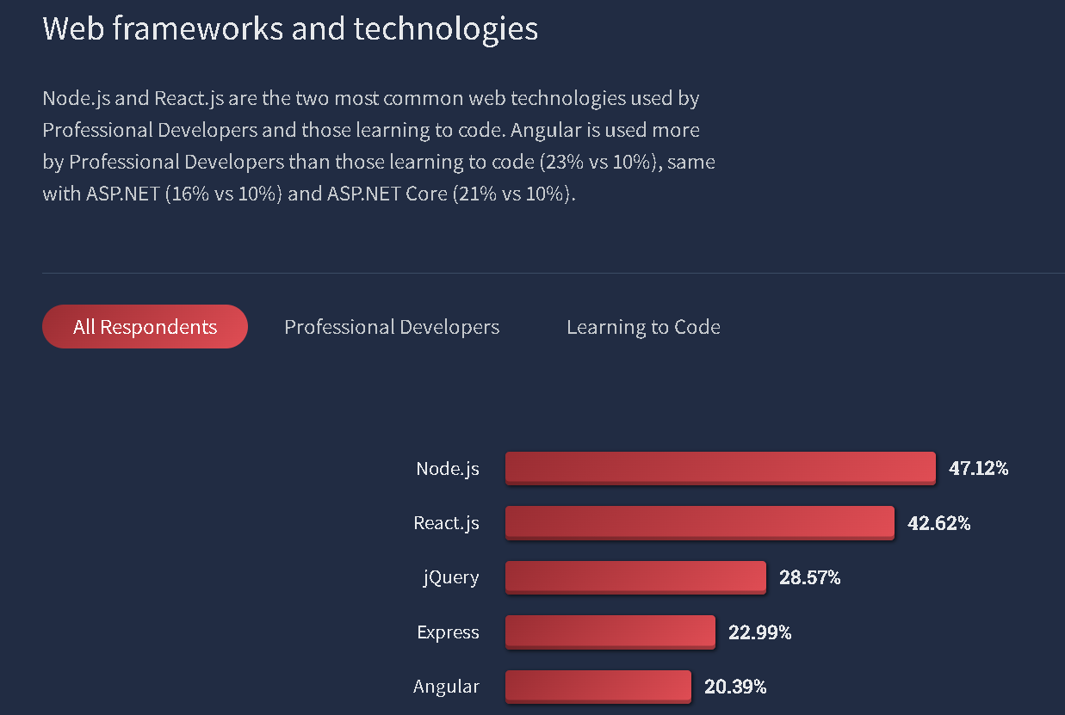
StackOverflow Survey 2022

Slide 11
Document Object Model (DOM)
Internal representation of HTML in browser
models a HTML document as an hierarchical upside down tree
each node of the tree is an object representing a part of the document.
DOM exposes a cross platform API
Allowing JavaScript programs to modify nodes of the trees
Thereby adding interactivity to the UI
Notes:
So how did a Javascript program running in the browser do all the magic that we saw just now ?
Well, its basically through manipulation of the DOM tree
So the Document Object Model (DOM) is a cross-platform and language-independent interface that treats a HTML document as a tree structure wherein each node of the tree is an object representing a part of the document. Browsers represent a HTML page internally in memory as a DOM tree, where each HTML tag becomes a node or object of the tree.

Slide 12
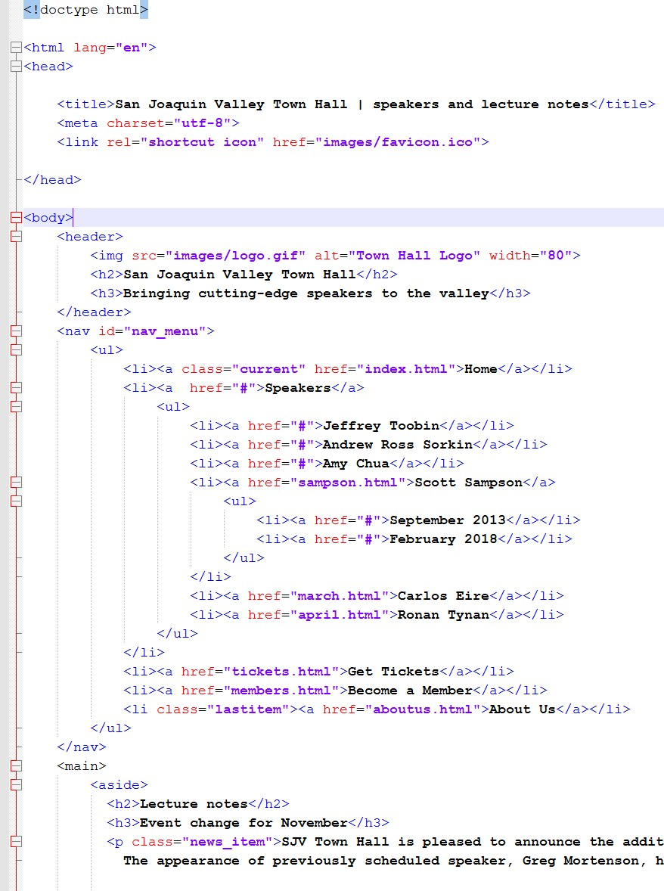

Document Object Model (DOM)
Notes:
So when the browser loads a HTML file along with is corresponding CSS stylesheet, it represents it internally in memory as a DOM tree like this. Each node or object in the tree corresponds to a specific HTML element in the original HTML document.

Slide 13
Document Object Model (DOM)
JavaScript program
Notes:
The DOM tree is subsequently exposed as an API to a Javascript program which can then call methods or access properties on any of these objects in order to:

Slide 14
Document Object Model (DOM)
JavaScript program
Modify any of the DOM elements and properties
React to all existing user events
Notes:
add, change, and remove any of the DOM objects and properties
react to all the existing user events, such as mouse clicks and hover events, text typed and so on

Slide 15
Document Object Model (DOM)
JavaScript program
Unchanged on hard disk
Dynamically changing in memory
Notes:
An important point to note here is that once the browser has created an internal DOM to represent the HTML file when it is initially loaded, the view shown in the browser window is based on this in-memory DOM, and not the original HTML file. So any dynamic changes made to the DOM by a Javascript program are immediately shown in the browser window as in the memory game that I demonstrated earlier, while the original HTML remains unchanged on local storage.
{Action: show memory game video demo in upper right hand corner]

Slide 16
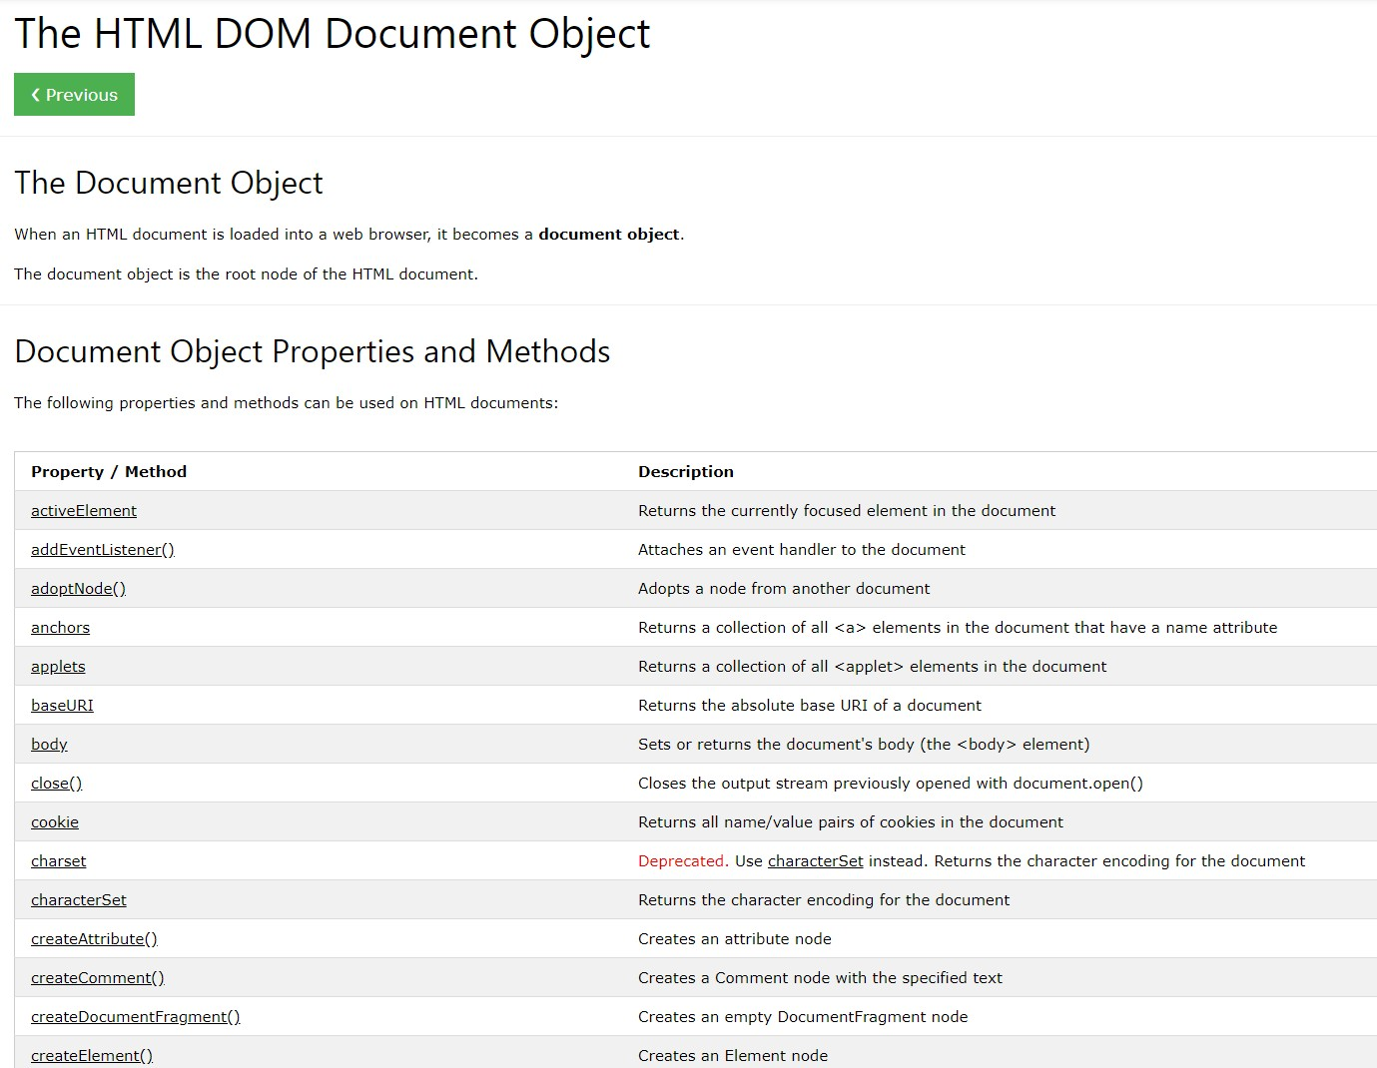
DOM API
accessible via JavaScript code
Notes:
And here is a list of some of these DOM object properties and methods accessible to a Javascript program from a reference list that is given in your lab manual. Don’t worry, we will be getting our hands dirty with these soon when we start working with Angular.
I hope this has been a useful revision and I look forward to seeing you in the next lesson !

Slide 17
React basics
React Overview

Slide 18
React (React.Js) Overview
JavaScript library developed by Meta to build frontend UIs for both web and mobile platforms
provides a collection of functionalities that facilitate the implementation of interactive and reactive UIs
simplifies the creation and management of complex UIs
One of the main approaches used for developing Single Page Applications (SPAs)

Slide 19
Multi page Apps (MPA)
Traditional approach to constructing web sites / web apps
Starts with initial load of HTML / CSS / JavaScript
when user navigates to a link requiring new content, request is made to backend server which returns a new HTML document
This may include existing content on current page as well as reloading of the same JavaScript code and / or CSS
If content change is minimal in navigation
Excess redundant content is returned which increases network latency and reduces website interactivity

Slide 20
Single Page Apps (SPA)
Also starts with initial load of HTML / CSS / JavaScript (like MPA)
After this, no further full page reloads are performed
When a user navigates a links that requires new content
Request is made to backend server which returns content in a lightweight form (for e.g. JSON or XML) instead of a complete HTML web page
Returned content is then rendered by the JavaScript program in the browser at the appropriate location in the single page that was returned at the initial load.

Slide 21
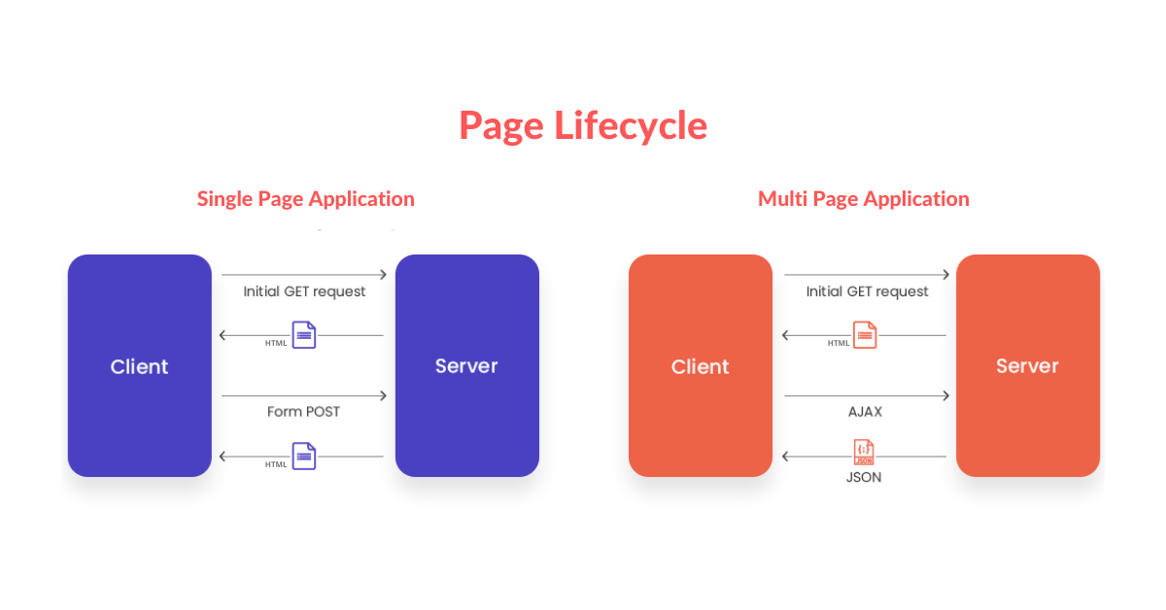

Slide 22
Single Page Apps (SPA)
SPA provides a significant gain in performance compared to MPA
Particularly for apps where minimal change in content on the web page in response to user interactions
as there is no overhead of having to load HTML, JavaScript and CSS again
Provides a more fluid and dynamic experience within the browser
Approaching native app performance on mobile devices.

Slide 23
SPA techniques
JavaScript frameworks
Angular, React, Vue, Ember
Ajax in JQuery
using XMLHttpRequest (XHR)
WebSockets
HTML5 specification
Notes:
Finally, WebSockets are a bidirectional real-time client-server communication technology part of the HTML5 specification and are considered superior to Ajax in terms of performance and simplicity.

Slide 24
StackOverflow Survey 2022

Slide 25
React features
Uses a declarative approach to UI
vs imperative approach used in vanilla JavaScript
This allows developers to focus on the core business logic
Rather than worry about the details of DOM manipulation when using vanilla JavaScript

Slide 26
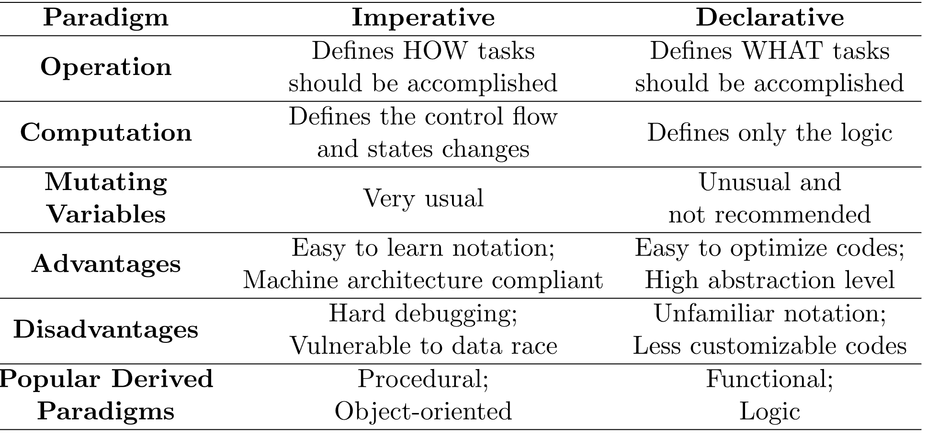

Slide 27
React features
Based on MVC architecture
the view layer is responsible for the UI that the user interacts with
Uses components as building blocks of complex UI
React app is typically composed from a component hierarchy
Component state can change over time, which results in changes in how it is displayed in the browser view

Slide 28
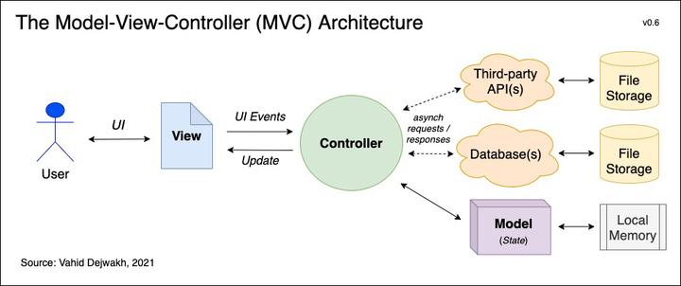

Slide 29
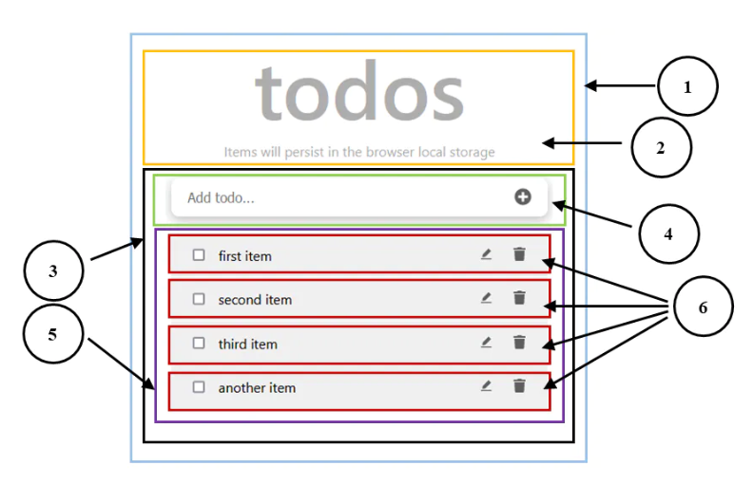
React App built from components

Slide 30
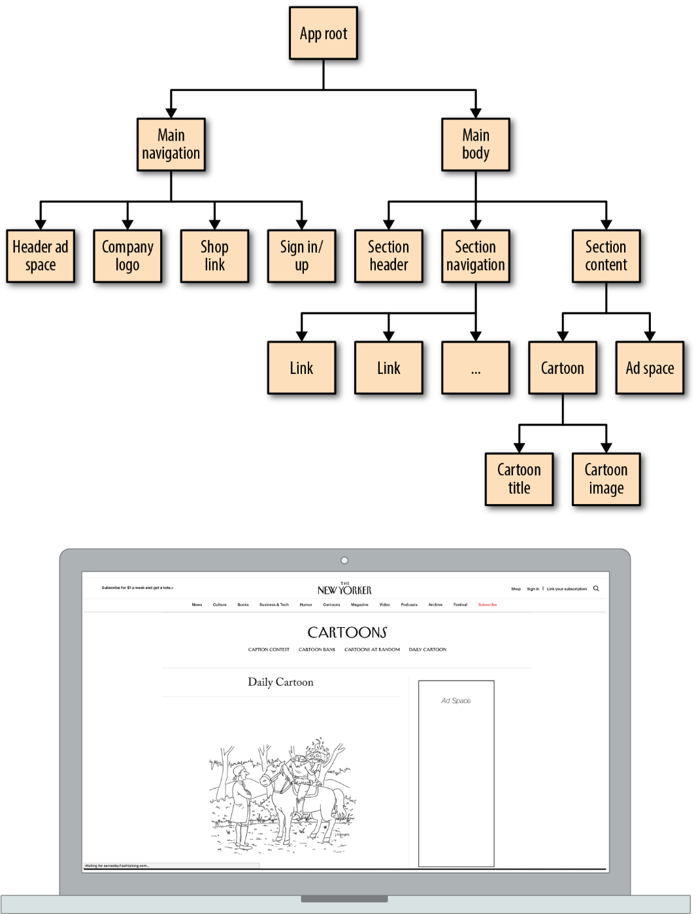
Component hierarchy

Slide 31
React features
Uses a virtual DOM to speed up rendering
This is a lightweight representation of the actual browser DOM that is faster to manipulate
Any changes in component state is used to update virtual DOM
actual DOM is updated based only on the differences between it and the virtual DOM
this is much faster than updating the entire actual DOM

Slide 32
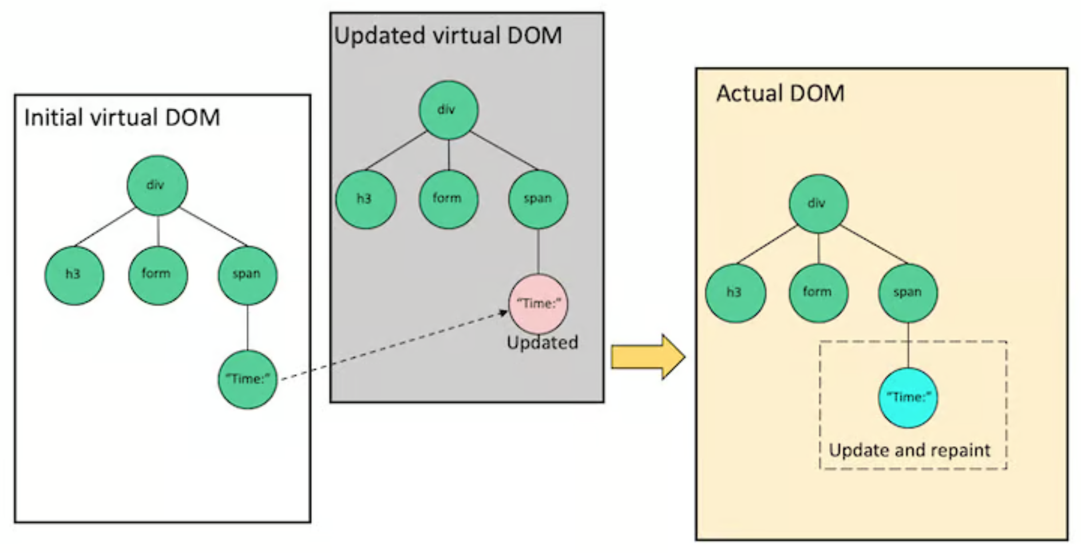

Slide 33
React features
Uses a special syntax called JSX
syntactical sugar that resembles HTML
Translated into JavaScript that creates the virtual DOM
this is compared to the actual DOM to determine the actual DOM-manipulating instructions to generate to update the browser view

Slide 34
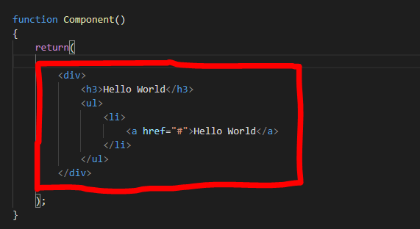
React JSX

Slide 35
React features
Core React is purely focused on UI
Does not incorporate many of the other features required for full blown front-end web development (unlike frameworks such as Angular)
Easily extended by incorporating supplementary libraries
Create-React-App: for generating React project structure
React Router: for routing
Redux: for complex state management
Material UI, AntDesign, Bootstrap: enhancing component design
Entire ecosystem of supporting libraries are available

